Slide 1
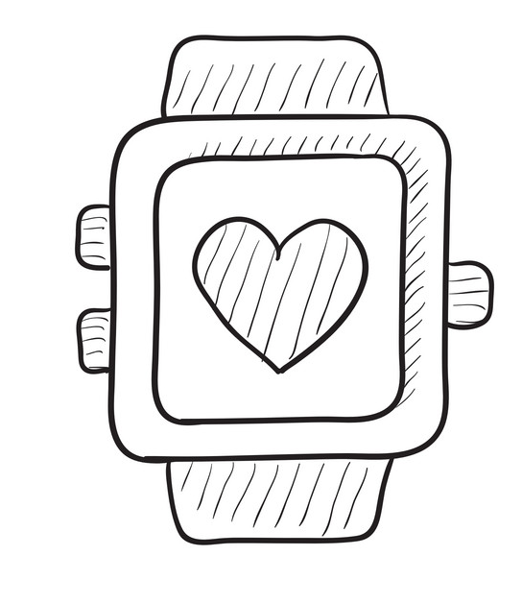
Using KubeEdge in Smart Watch Project
KubeEdge Community Meeting
May 11, 2022

Slide 2
The Smart Watch Project

Slide 3
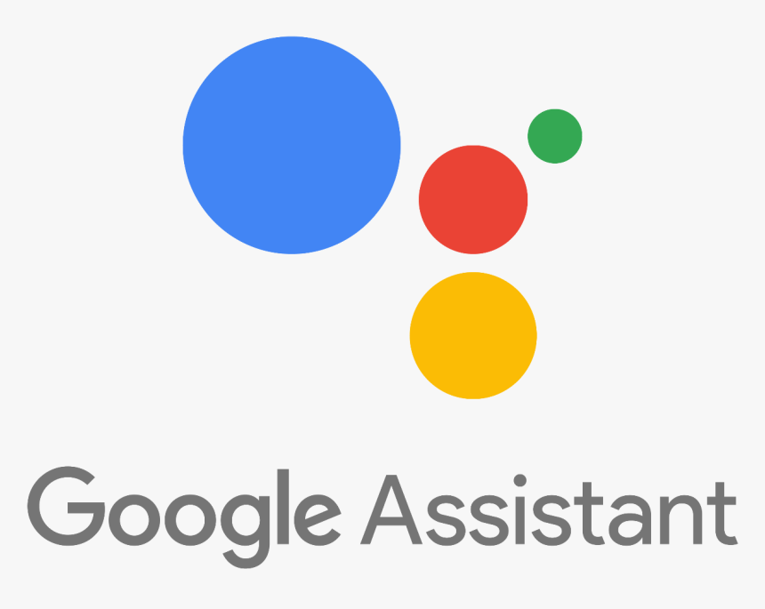
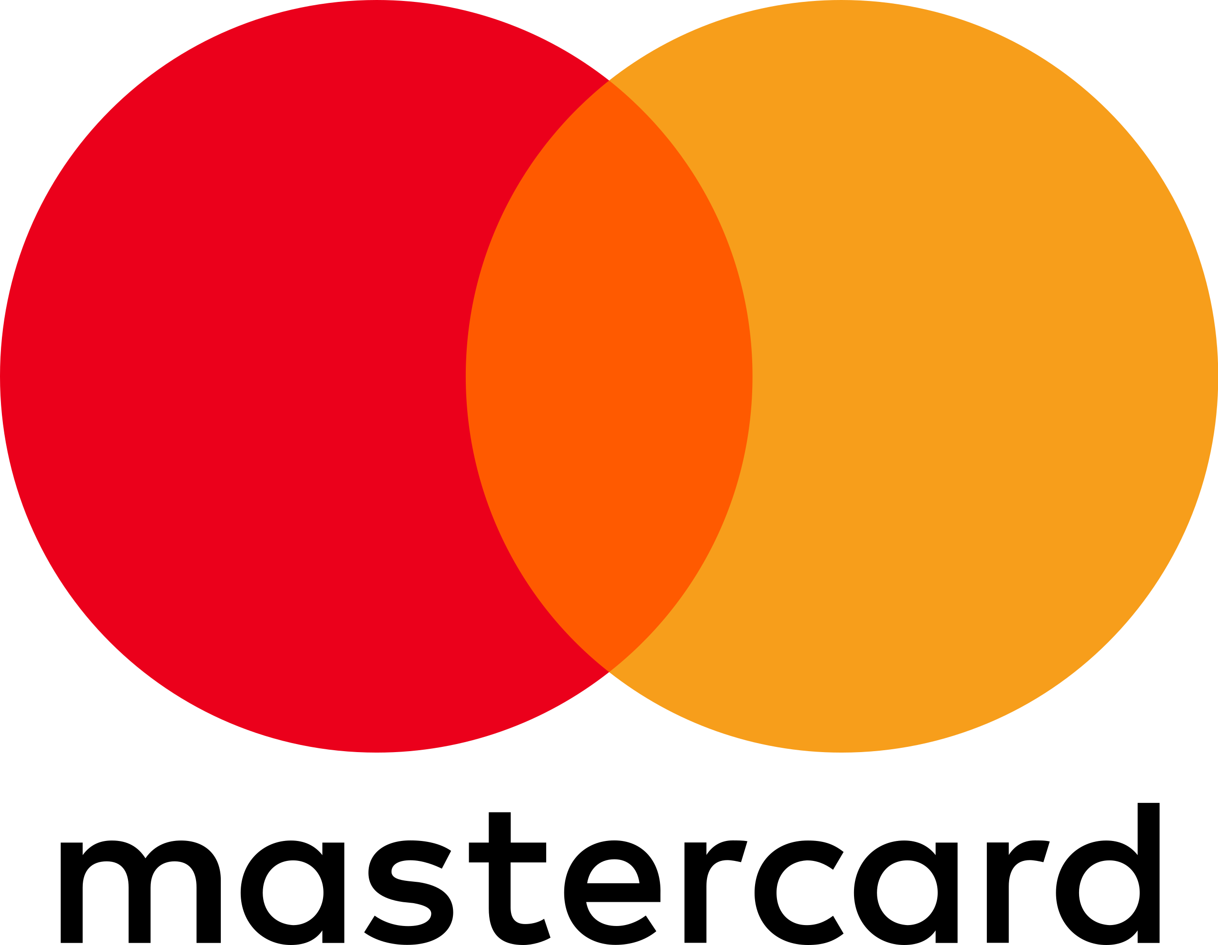
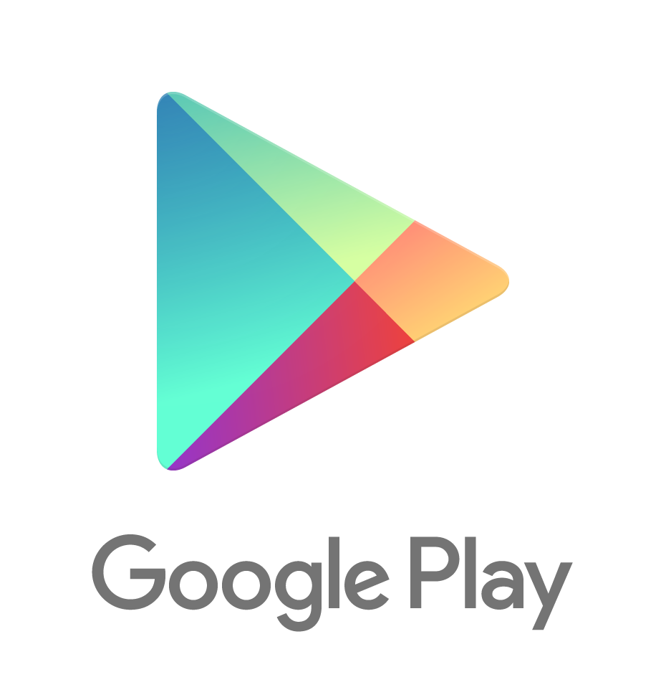
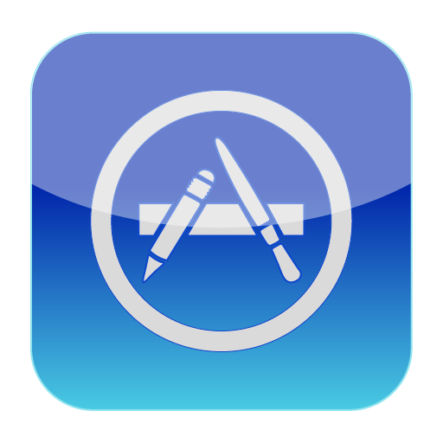
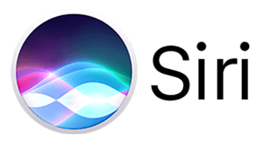


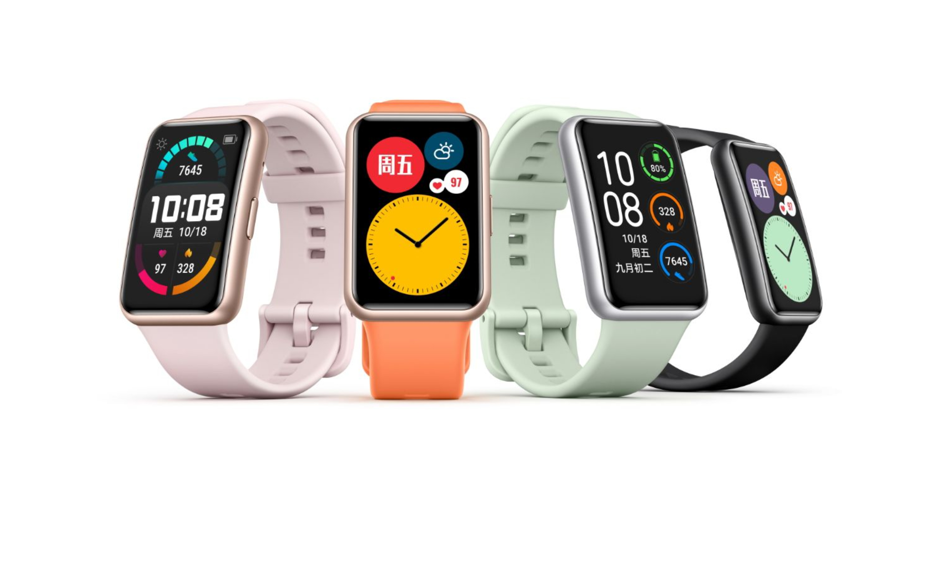
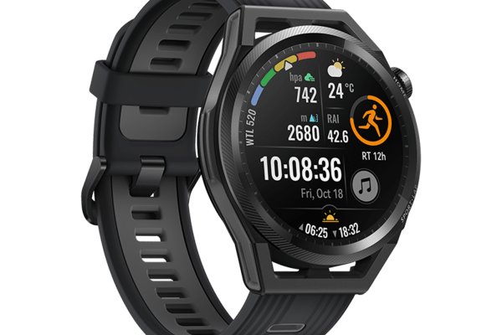
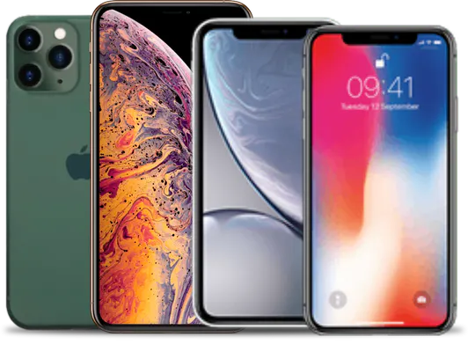

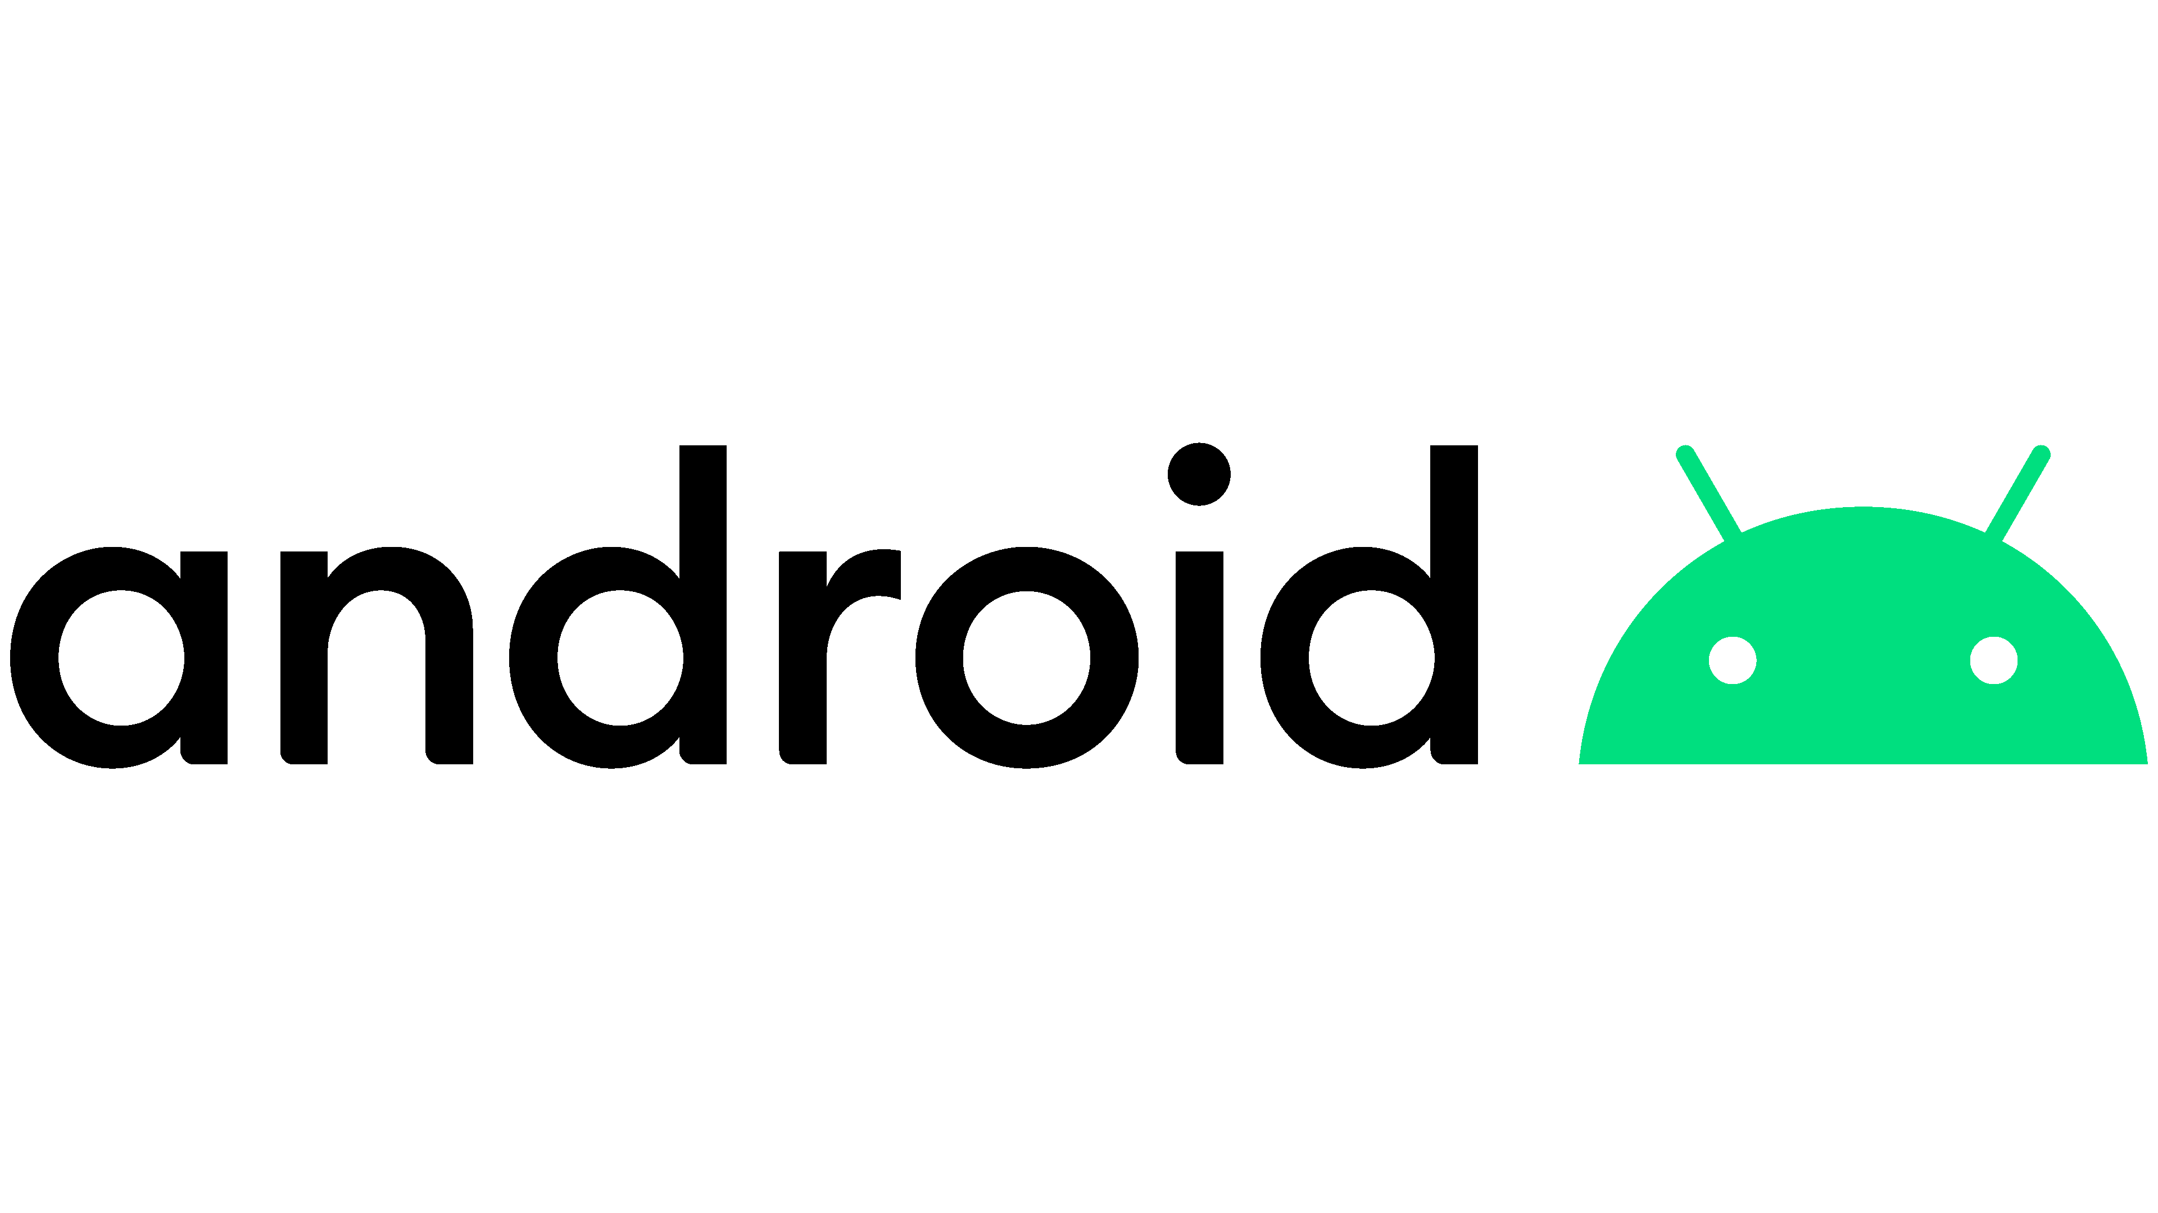
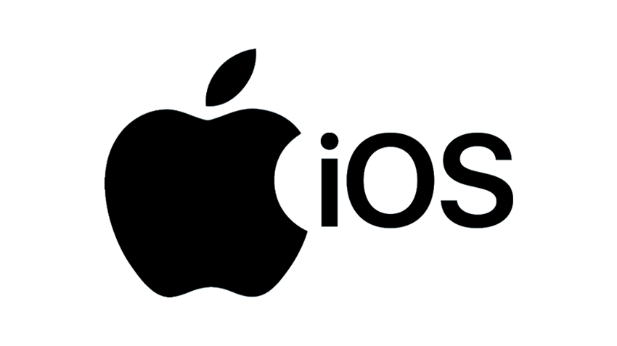
KubeEdge Smart Watch Project
Voice Assistant Integration
Visa & Master Card Payment Integration
Smart Watch used as main user interface
Notification to users, accept user input & display info
Voice assistant support with Google Assistant & Alexa
Contactless payment, send to smartphone for processing
Media player, media content from smartphone
KubeEdge Cloud Edge Integration to support Push Notification with Smart Watch app
Apple
AppStore
Smartwatch app integrate with 3rd party apps to support new smartwatch functionality
Smart Watch (Interface with users)
Smart Phone (Integration with 3rd party)
Launcher
Service Handler
App Services
Smartphone interact with Smartwatch via open API using Bluetooth
Playback Services
Content Provider
Smart Watch OS

Slide 4
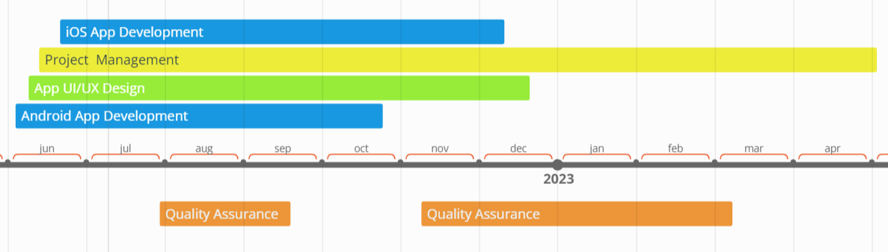
Phase 1 Estimated Project Schedule
Resources on the project will include developers per platform (iOS and Android) as required to meet project timeline.
UI/UX Designers & Project Manager work with developers as a team with required skills needed to support this project.
Phase 1 : Q4 2022 release of Android & iOS Beta App, Q1 2023 Official Release on Android Play & iOS App Store.
Android Beta App Release
iOS Beta App Release
Official Release
Q1 2023

Slide 5
KubeEdge

Slide 6
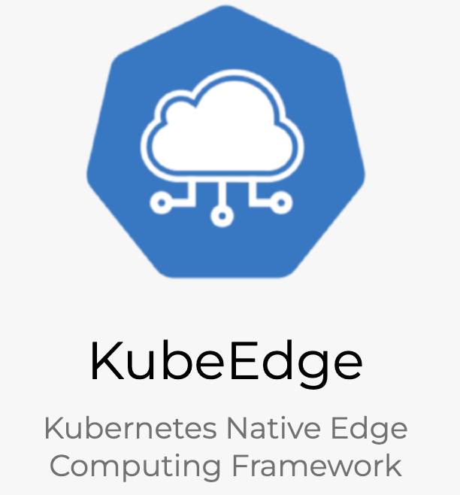
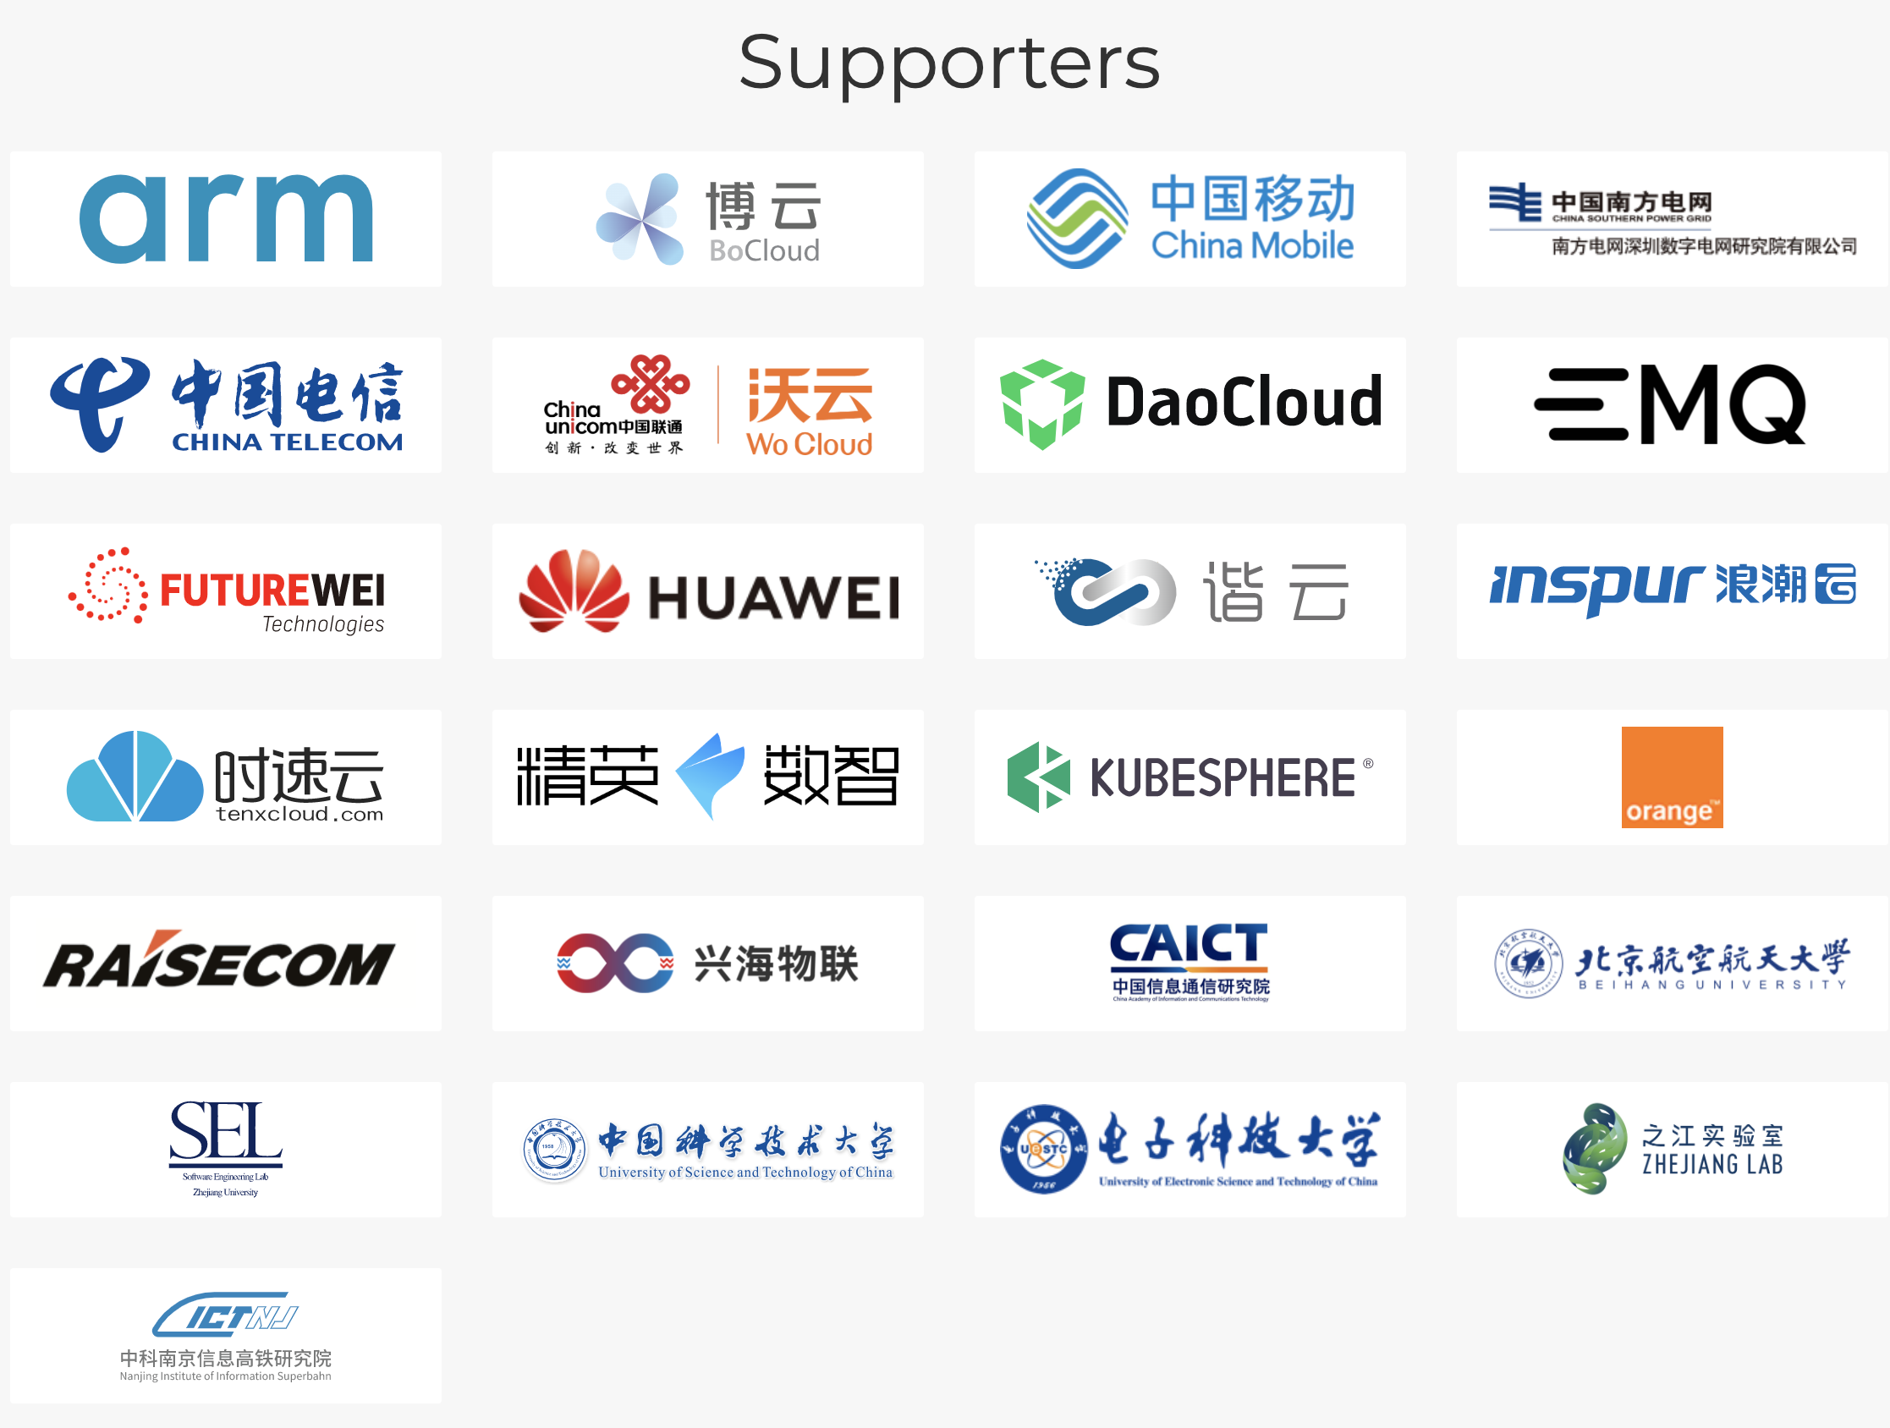
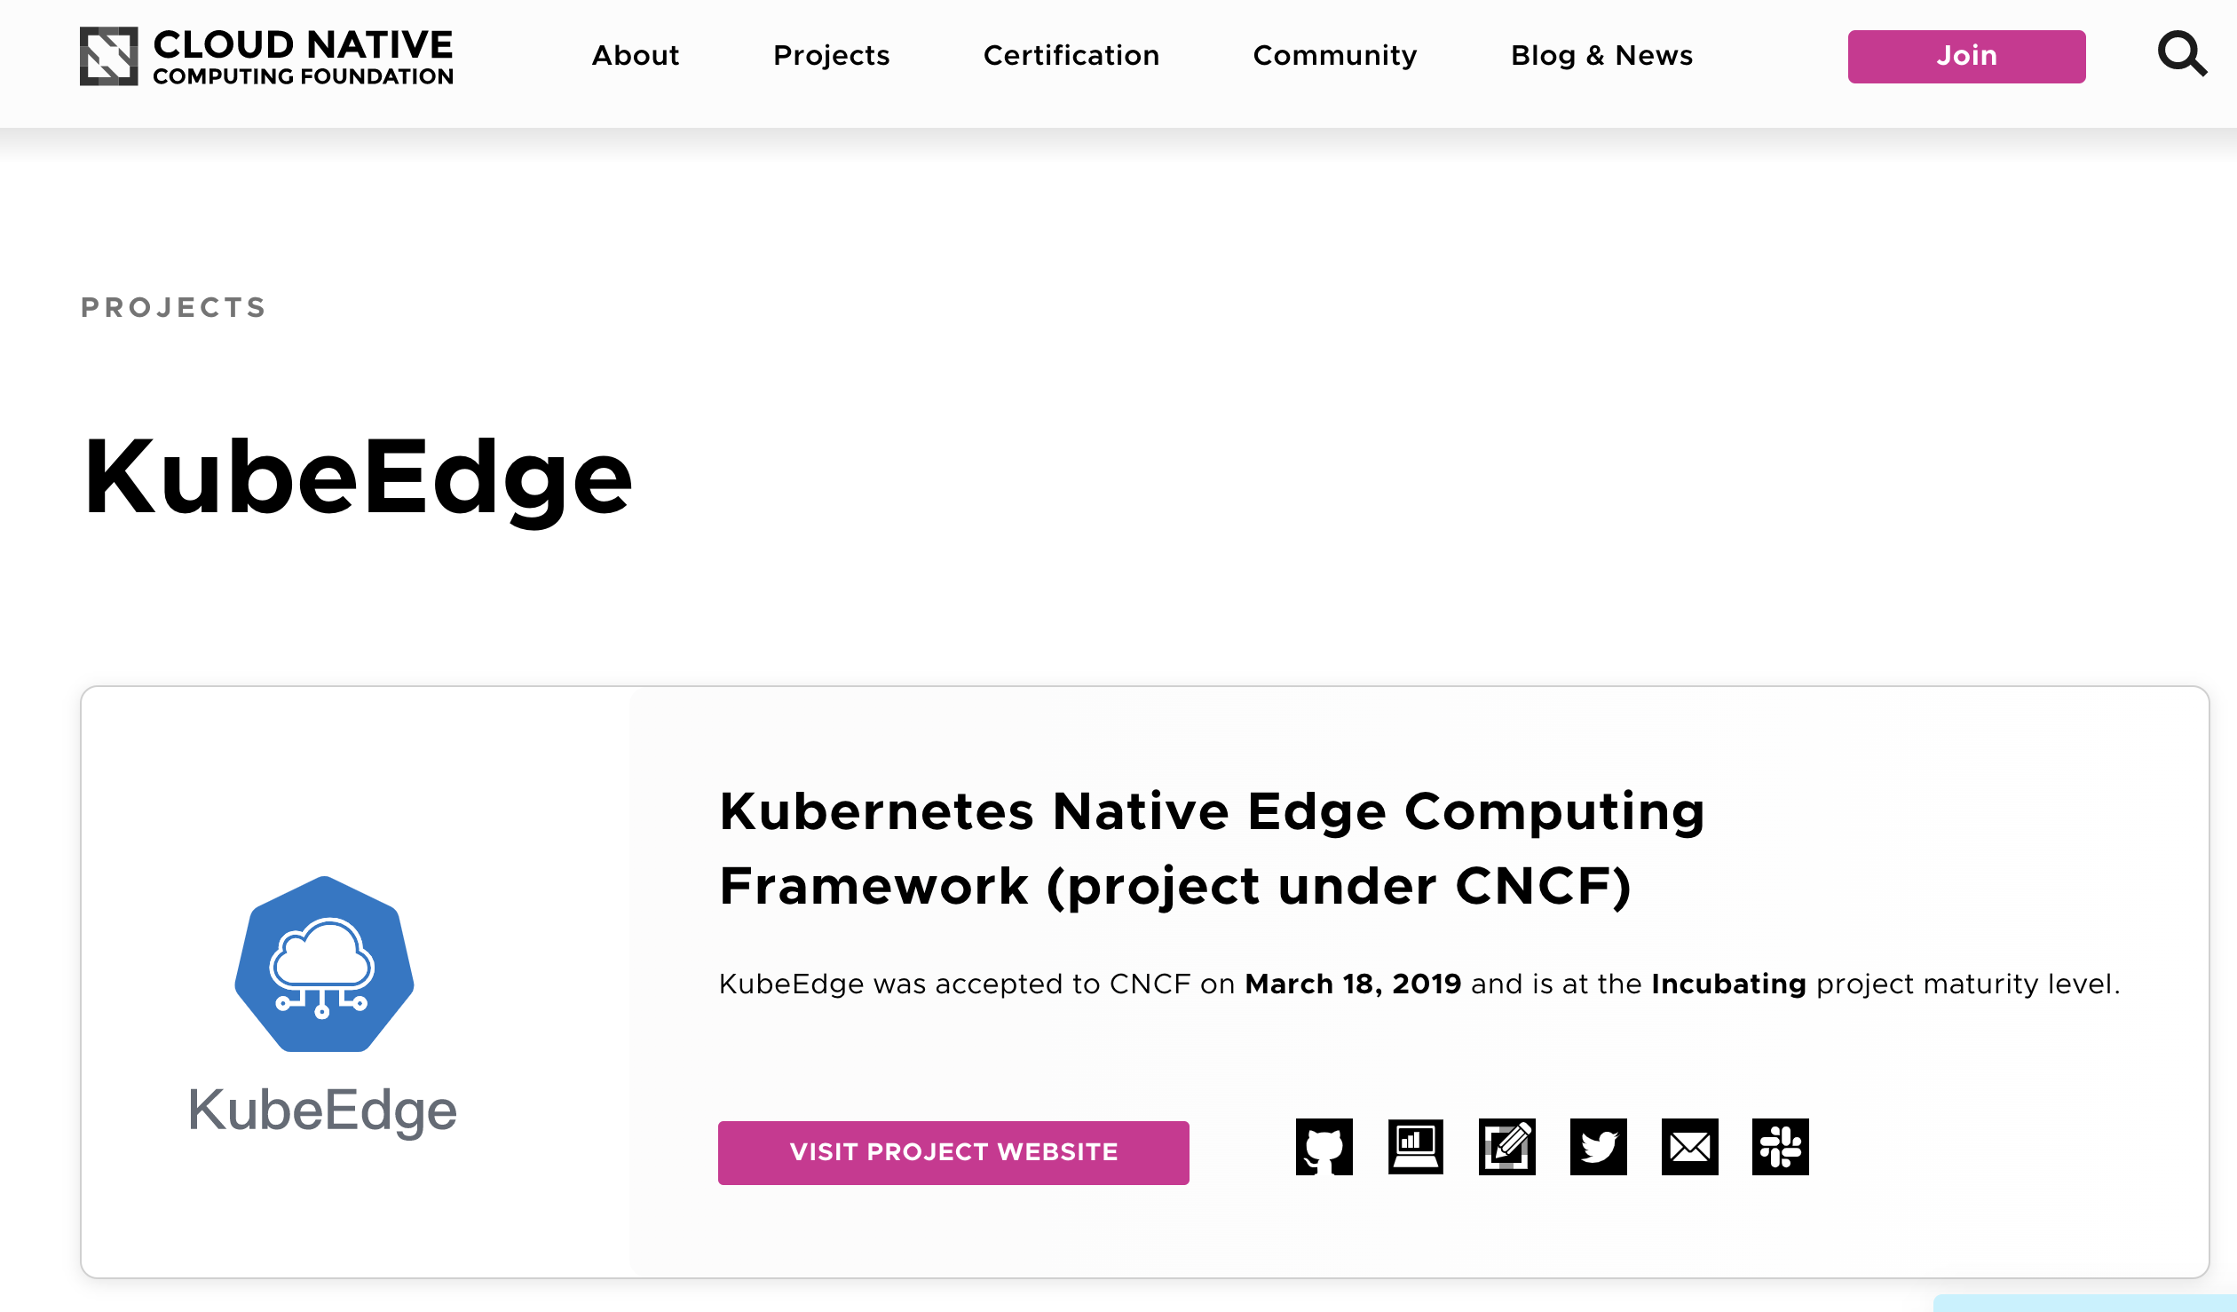
Kubernetes-native support
Containerized workload
Reliable Cloud-edge Collaboration
Edge Autonomy
Edge Device Communication
Heterogenous & Low Resource Ready
云原生 / 云-边-端协同 / 自治边缘 / 容器化应用
CNCF Incubating Project

Slide 7
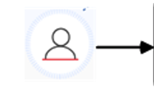
KubeEdge (Simplified Architecture)
pod
pod
pod
K8S
API Server
Cloud Core
Cloud
Edge
WebSocket
Device
Edge Core
Device
pod
pod
Device
Edge “node”

Slide 8
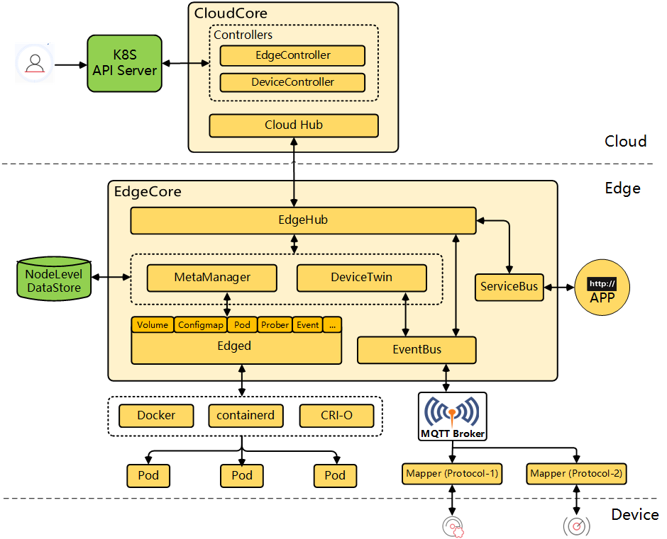
KubeEdge Architecture

Slide 9
Benefit of using KubeEdge
Cloud-native application lifecycle management
Containerized application
Multiple device platform , e.g.
Android
Apple IOS
Harmony OS
“./app.exe” vs “kubectl create –f app.yaml”

Slide 10
Architecture

Slide 11
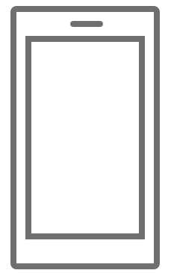
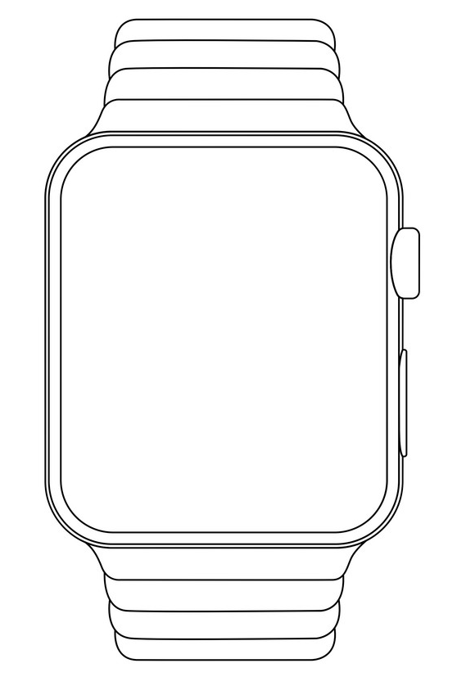

Architecture
Cloud K8s CP Node
3rd party services
Cloud Core
Cloud Node
C
Cloud Node
Cloud Node
Cloud/Edge DC
Edge
WebSocket
Edge Core
C
C
C
Device-Edge Connection
C
Smart device
container

Slide 12
Key Features To PoC

Slide 13
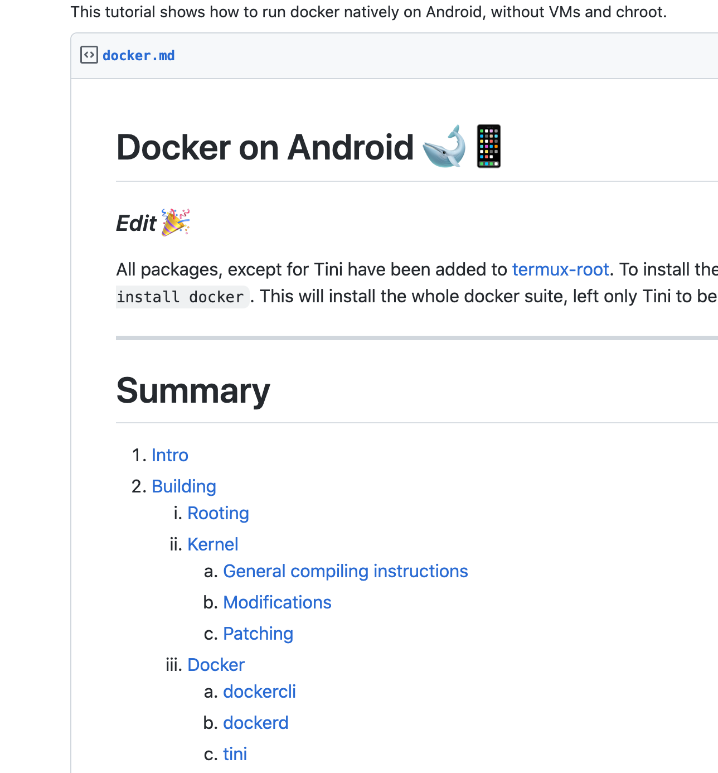
(1) Running EdgeCore on Smart Devices
EdgeCore
Runs as a process
Runs edged which is similar to kubelet
MySQL light
User APP
Container
SQLite
Edge Core
C
C
C
link1
link2

Slide 14
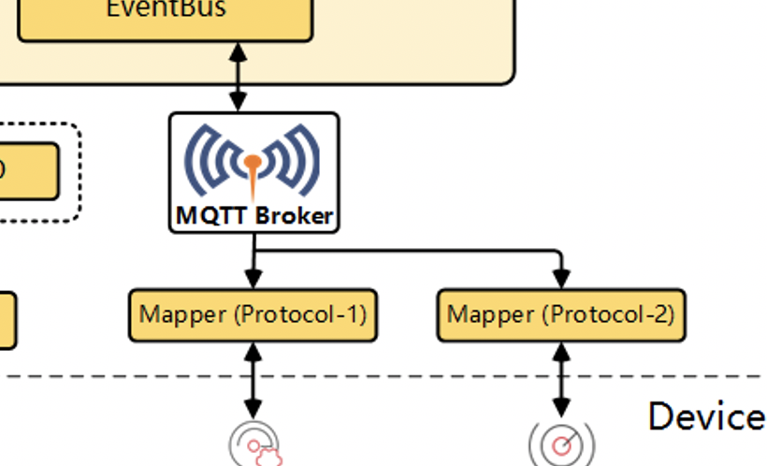
(2) EdgeCore to Smart Watch Connection
MQTT Device Broker
Bluetooth over MQTT
Edge Core
OpenHarmony

Slide 15
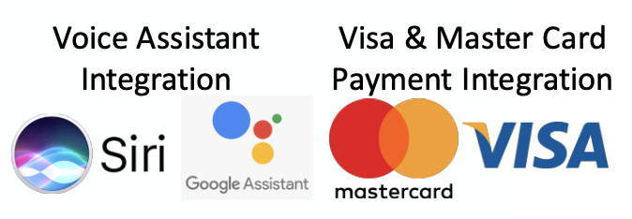
(3) User APP calling 3rd Party Service
Cloud Node
C
Cloud Node
Cloud Node

Slide 16
KubeEdge Work Items
Cloud K8s CP Node
Cloud Setup
Run KubeEdge cloud-core
Cloud VMs such as AWS
Run K8s
Run edge-core
Validation/Deliverables:
For K8s: kubectl get nodes, get pods
For edge-core: process up running successfully
Test pod
A containerized application in a K8s that could be used to validate phone-watch functionalities
Validation/Deliverables:
K8s Poddefinition in yaml
Smartphone Setup
Run KubeEdge edge-core
Optional: on a separate cloud VM machine for KubeEdge validation
On smartphone
Validation/Deliverables:
“kubectl get nodes” from cloud machine should show the edge-machine (smartphone and/or VM node)
Deploy test pod from cloud machine (through cloud-core)
Running test pod using edge-core
Cloud side shows correct status of the edge test pod
Edit and delete edge test pod works correctly
Smartwatch Setup (
Bluetooth connection with testing pod running on the edge machine/smartphone
Validation/Deliverables:
Test pod able to communicate with smartphone via Bluetooth or other protocols
Cloud Core
Cloud Node
Cloud Node
Cloud Node
WebSocket
SQLite
Edge Core

Slide 17
Thank You Questions?

